Slide 1
C++ Programming Language
Chapter 1 + 2

Slide 2
C++ Standard Library
As you’ll learn later, C++ program is a collection of functions
Function: a collection of statements
You can write your own functions to form a C++ program, and/or take advantage of the rich collection of existing functions called the C++ Standard Library

Slide 3
C++ Standard Library
Prewritten code (program) that programmers can use in their own programs
When programming in C++ you’ll typically use one of the following:
  C++ Predefined/Standard Library functions
  Functions you write yourself

Slide 4
Program development steps: Editing
You can use a text editor or IDE to create a C++ program called a source program
You type a C++ program with the editor, make corrections, if necessary, then save the program.
The program must be saved with the extension .cpp

Slide 5
Program development steps: Preprocessing
As you will see later, most C++ programs start with the statement #include <iostream>
This statement is called a preprocessor directive
They are commands that tell the computer the locations of the code provided in libraries such as iostream
These statements are processed by a program called preprocessor

Slide 6
Program development steps: Compiling
The compiler verifies that the program obeys the rules of the programming language i.e. checks the source program for syntax errors
If no error is found, it translates the program into a machine language program
This machine language program is called object program

Slide 7
Program development steps: Linking
C++ programs typically use functions defined elsewhere, such as in the standard libraries
The object program produced by the C++ compiler typically contains “holes” due to these missing parts
A linker is a program that links the object program with other programs in the library to create the executable program (with no missing pieces)
If the program compiles and links correctly, an executable file is produced

Slide 8
Program development steps: Loading
Before a program can be executed, the program must first be loaded into memory
This is done by the loader

Slide 9
Program development steps: Execution
Finally, the computer, under the control of its CPU, executes the program one instruction at a time
Run-time errors may occur while program execution
For example, a program might attempt to divide by zero (an illegal operation on computers just as in arithmetic)
This causes the program to terminate immediately giving an error message

Slide 10
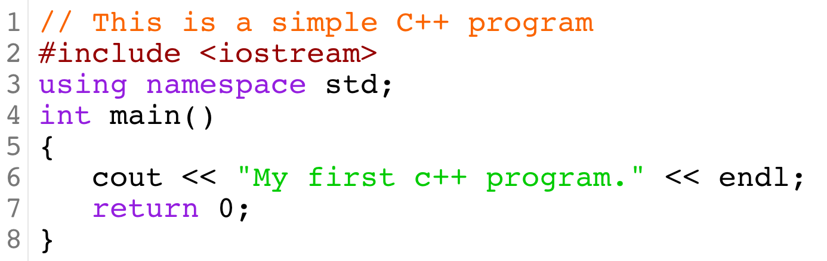
A Simple C++ Program: Printing a Line of Text
comment
Preprocessor directive
Namespace for iostream identifiers
Main function
block
statement
Output:
My first c++ program.

Slide 11
A Simple C++ Program: Comments
Line 1
    // This is a simple C++ program
Begin with //, indicating that this line is a comment
Comments are added to help the reader of the program to understand the code
Comments can be used to give a brief explanation of the program and the meaning of key statements in it
Comments are completely ignored by the C++ compiler

Slide 12
A Simple C++ Program: Comments
/* and */ can also be used to add multiple line comments
The compiler ignores anything that appears between /* and */
Example:
/* You can include comments that can
occupy several lines. */

Slide 13
A Simple C++ Program: Preprocessor Directives
Line 2
    #include <iostream>
  Placed as the first line of a program
  No semicolons at the end of preprocessor
  All preprocessor commands begin with #
Many of the functions needed in a C++ program are provided as a collection of libraries
The descriptions of the functions needed to perform input/output (I/O) are contained in the header file iostream
Preprocessor directives are commands that cause the preprocessor to include the contents of the iostream header file in the program

Slide 14
A Simple C++ Program: Blank lines and white space
Every C++ program contains whitespaces, such as: blanks, tabs, and newline characters
Used to make programs easier to read
White space characters are normally ignored by the compiler

Slide 15
A Simple C++ Program: The main function
Line 4
    int main()
Every C++ program includes the main function
A C++ program is a collection of functions, one of which is the function main
The left brace { marks the beginning of the (body) of the function main.
The right brace } marks the end of the body of the function main.
The pair of braces and the collection of statements between them is called a block.

Slide 16
A Simple C++ Program: The main function
Every program in C++ begins executing at the function main.
The keyword int to the left of main indicates that main “returns” an integer (whole number) value.
  We’ll explain what it means for a function to “return a value” when we demonstrate how to create your own functions.
For now, simply include the keyword int to the left of main in each of your programs.
The statement return 0; must be included in the function main and must be the last statement

Slide 17
A Simple C++ Program: Output statement
Line 6
    cout << "My first c++ program." << endl;
cout identifier and the operator << are used to print on the screen the string of characters marked by the double quotations
<< operator is called the stream insertion operator
endl causes the cursor to move to the beginning of the next line
The entire line is called a statement
Every statement must end with a semicolon ;
When the statement is executed, it prints the message “My first c++ program.” on the screen as it exactly appears between the double quotes “”.

Slide 18
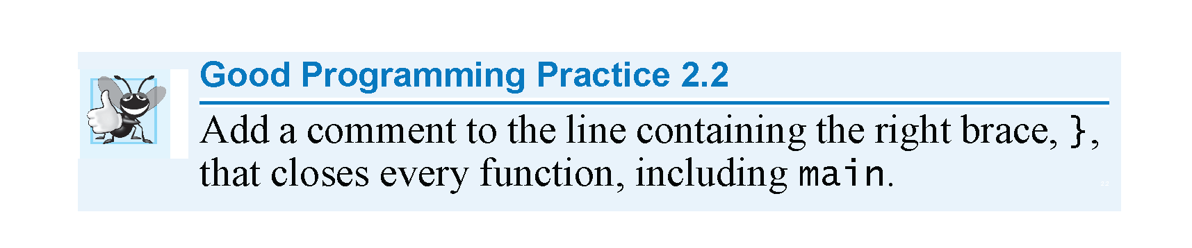

Slide 19
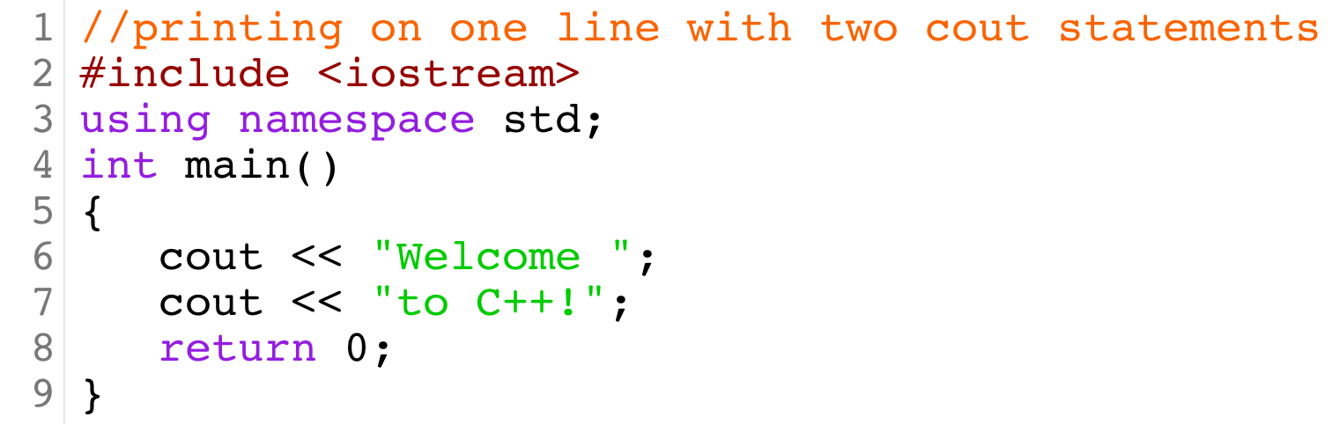
A Simple C++ Program

